Slide 1
“Spike sorting”
Kenneth D. Harris
University College London

Slide 2
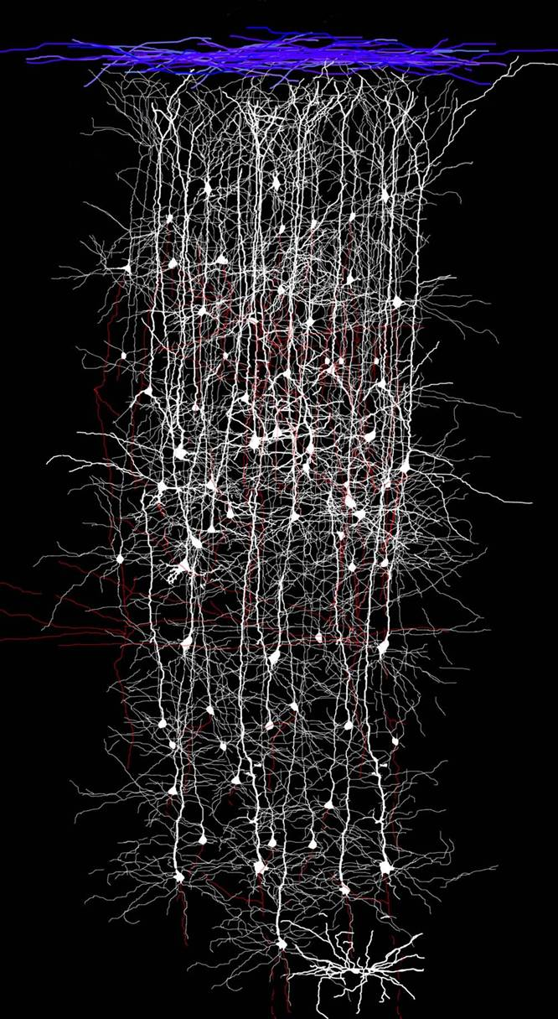
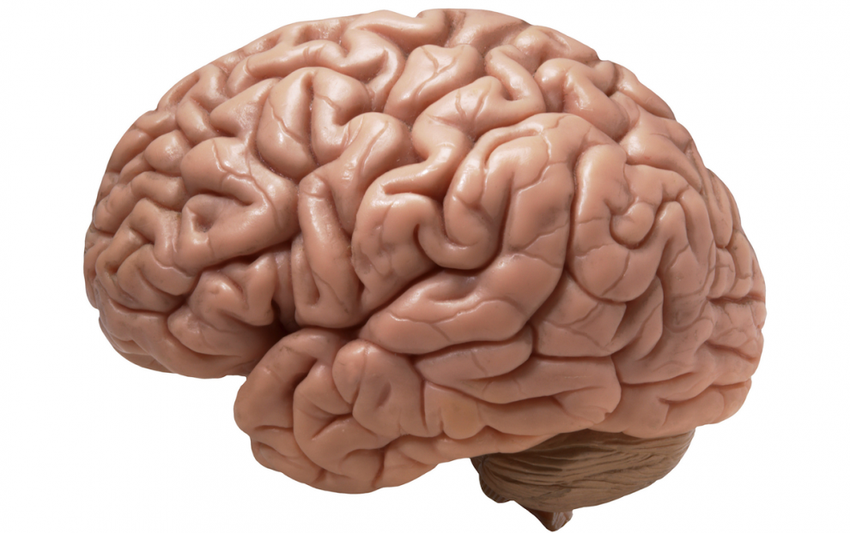
Brain contains billions of neurons

Slide 3

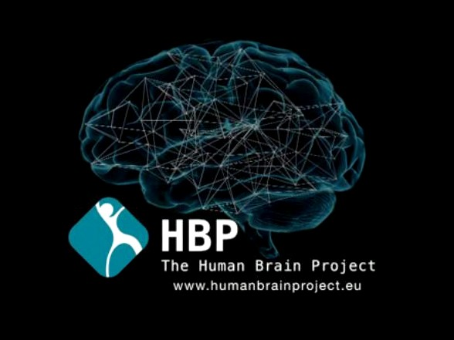
United states BRAIN initiative: $1billion
EU Human Brain project: €1billion

Slide 4
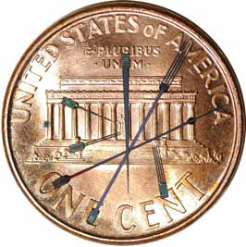

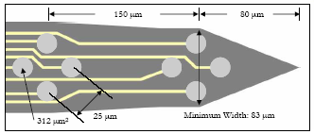
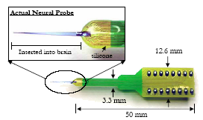
Silicon Microelectrodes
www.neuronexustech.com

Slide 5
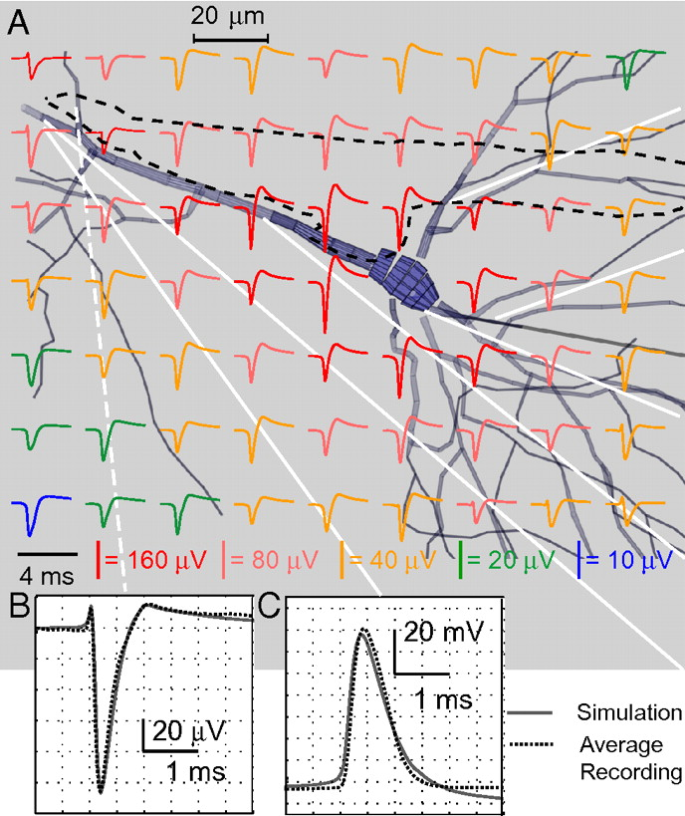
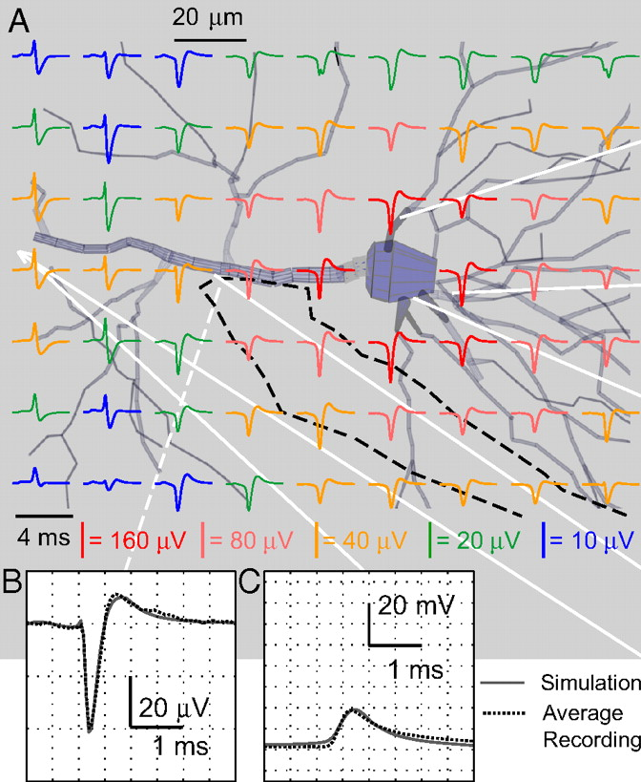
Extracellular voltage field
C. Gold et al, J. Neurophysiol 2006

Slide 6
“Tetrode effect”
Different cells have different waveform/amplitude profiles across channels
Allows about 15 neurons to be distinguished by a single tetrode

Slide 7
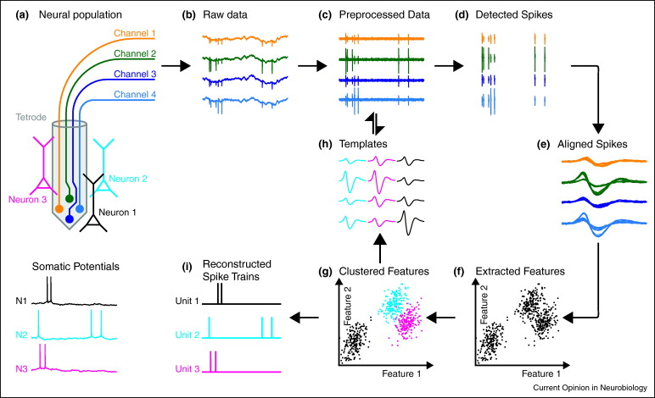
Traditional pipeline
Einevoll et al, Curr Opp Neuro 2012

Slide 8
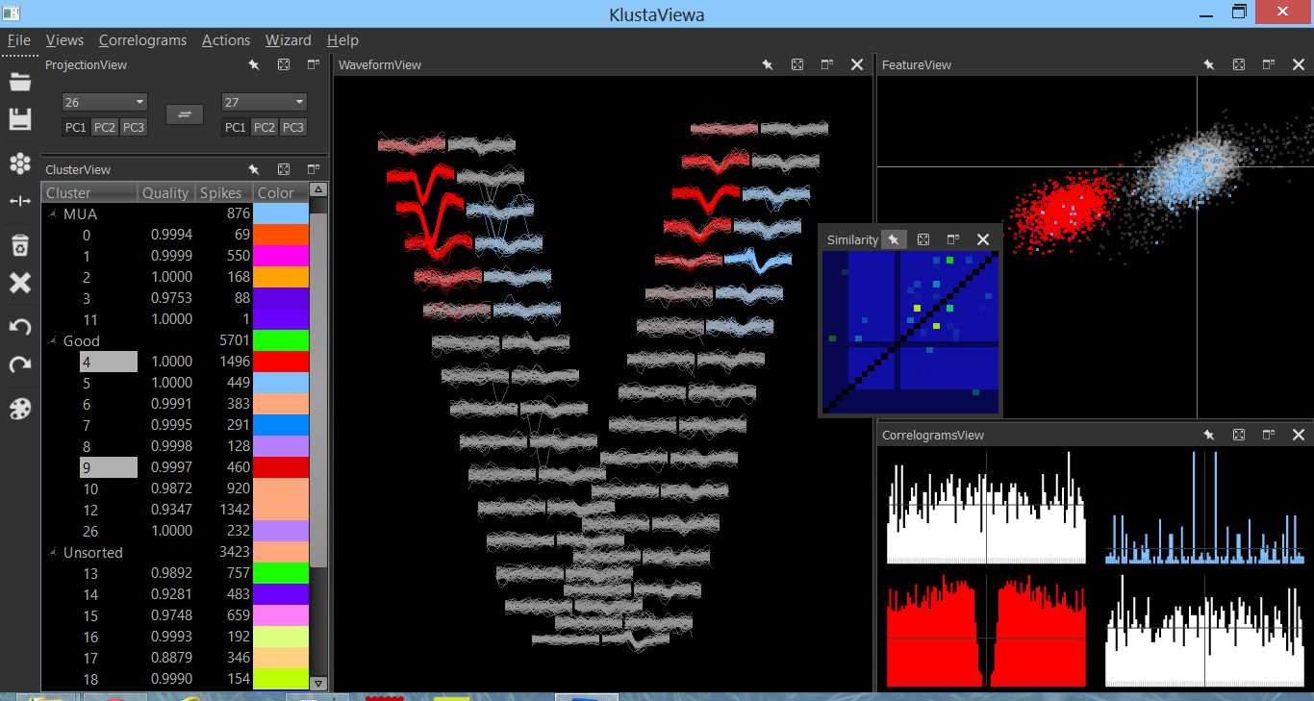
Traditional clustering approach
Mixture of Gaussians fit (12 dimensions)
Manual verification and adjustment
https://github.com/klusta-team/klustaviewa

Slide 9
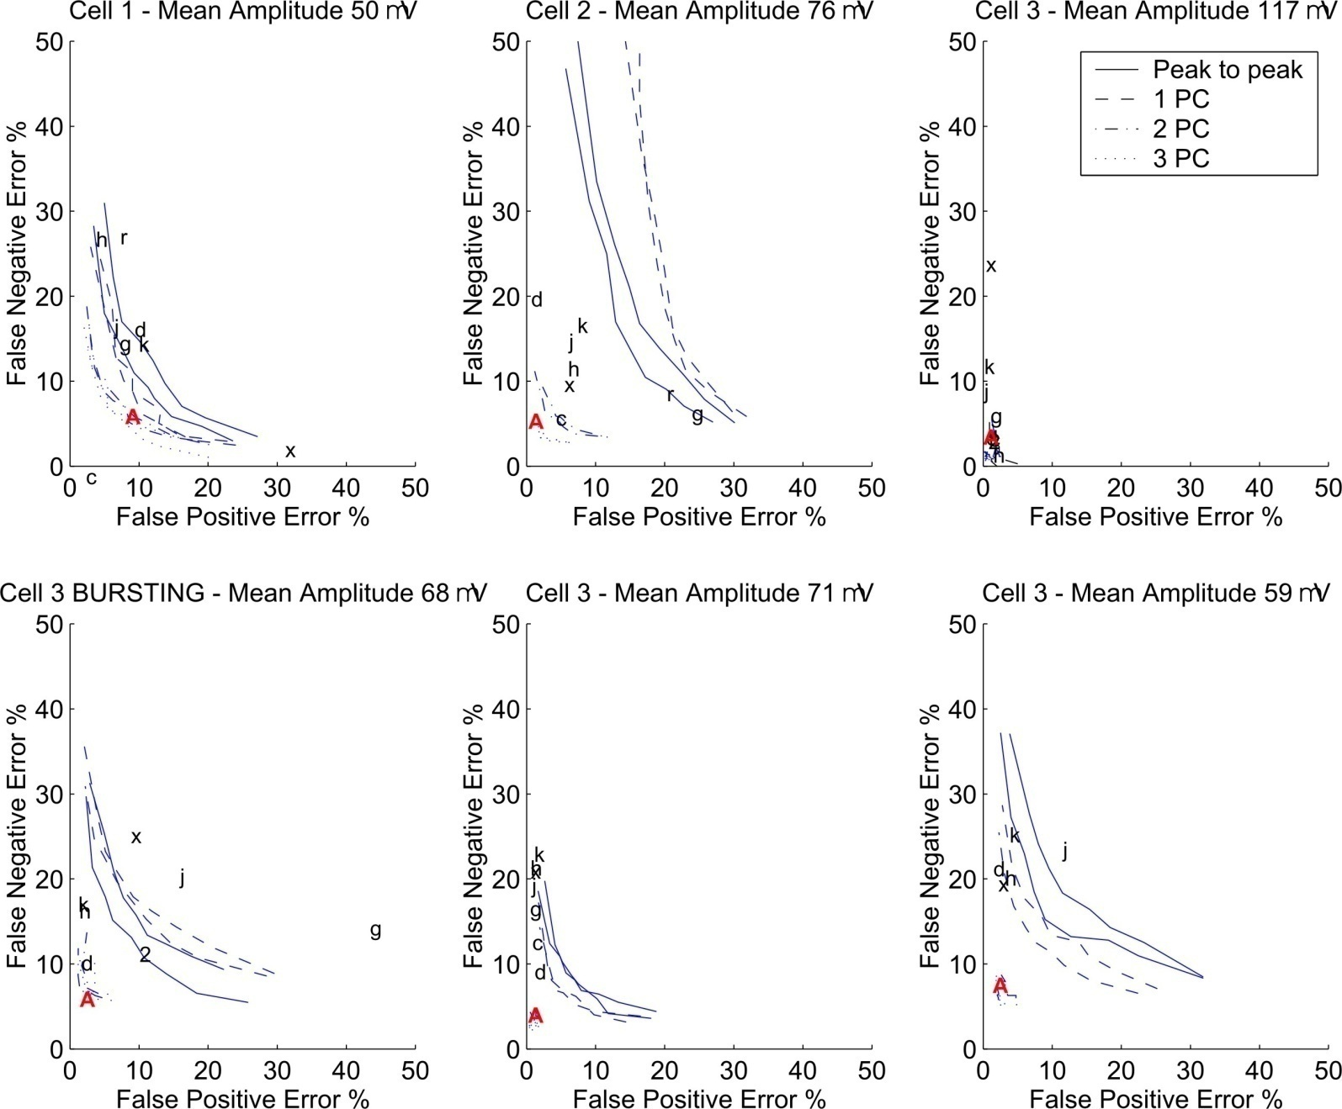
Error rates
Harris et al, J. Neurophysiol, 2000

Slide 10
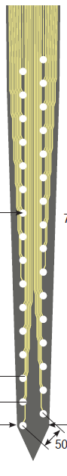
High density probes

Slide 11
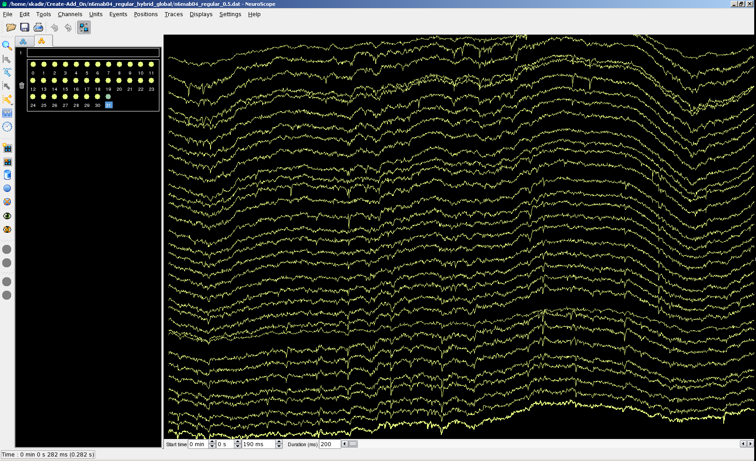

Slide 12
One approach
Local spike detection based on spatiotemporal continuity
“Masked EM algorithm” for cluster analysis based on local features
“Mask vectors”
show which channels have data
http://arxiv.org/abs/1309.2848
https://github.com/klusta-team/klustakwik

Slide 13




Thanks!
UCL:
Cyrille Rossant (KlustaViewa)
Shabnam Kadir (KlustaKwik, SpikeDetekt)
Harvard:
Dan Goodman (KlustaKwik, SpikeDetekt)
Berkeley:
John Schulman (SpikeDetekt)
NYU:
Gyorgy Buzsaki, Mariano Beluscio (Data)

